Slide 1
CoSA-NARA Webinar
February 11, 2021
3 pm Eastern
Executive Transitions in Federal and State Governments
Disclaimer: This webinar is being recorded and will be available for viewing on the CoSA website.

Slide 2
Welcome
Meg Phillips, External Affairs Liaison
National Archives and Records Administration
Barbara Teague, Executive Director
Council of State Archivists

Slide 3
Webinar Agenda
Welcome
Presentations from NARA
Presentation from Montana and Connecticut
Q and A
Announcements

Slide 4
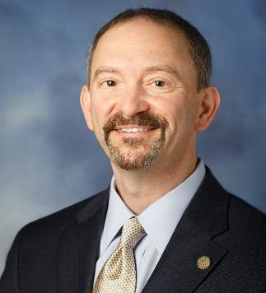
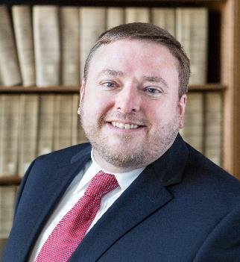
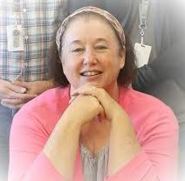
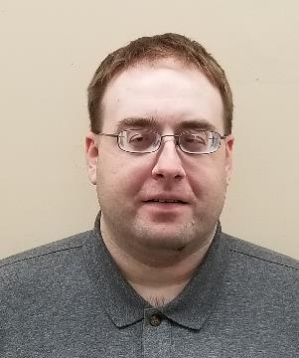
Presenters
Laurence Brewer
Chief Records Officer
NARA
John Laster
Director of the White House Liaison Division
NARA
Jodie Foley
Montana State Archivist, retired
Allen Ramsey
Asst. State Archivist, Connecticut

Slide 5
Transition and Records Management for Federal Agencies
Laurence Brewer, CRM
Chief Records Officer for the U.S. Government
NARA
Webinar for Council of State Archivists (CoSA)
February 11, 2021

Slide 6
Support for Federal Agencies
What is a Presidential Transition?
A presidential transition (or administration transition) is the process of planning for a new presidential term
The new term is either a new president entering office or a president starting a second term
What is the Center for Presidential Transition?
Run by the Partnership for Public Service (PPS)
Nonpartisan, nonprofit, non government organization (NGO)
Source of information and resources for transition
https://presidentialtransition.org
Legal Authority: 3 USC § 102 The Presidential Transition Act of 1963. Updated by the Presidential Transition Act of 2000 (P.L. 106-293), the Pre-Election Presidential Act of 2010 (P.L. 111-283), the Edward “Ted” Kaufman and Michael Leavitt Presidential Transitions Act of 2015 (P.L. 114-136), and the Presidential Transition Enhancement Act of 2019 (P.L. 116-121).

Slide 7
Support for Federal Agencies
https://www.gsa.gov/governmentwide-initiatives/presidential-transition-directory

Slide 8
NARA Approach to Transition
In times of transition, it is crucial that agency heads work with their Senior Agency Official for Records Management and Agency Records Officers to ensure that the importance of records management during transition is communicated within the agency ….
Memo from Archivist of the United States to Agency Heads, November 2020
NARA’s Office of the Chief Records Officer has updated and developed formal guidance, delivered briefings to agency officials, and published articles on Records Express for federal agencies and public stakeholders.
Message focused on good governance. In general, the same federal records management activities occur at the beginning of a second term as in the beginning of a first term.

Slide 9
Key Focus Areas
Email
Entrance & Exit
Social Media
Web

Slide 10
Resources and Contacts
Records Express blog posts:
Managing Official Email and Social Media Accounts
Entrance and Exit Checklists for Senior Officials
General Resources from NARA and GSA
NARA RM Website:
Memo to Agency Heads, November 2020
Documenting Your Public Service
Records Management Guidance for Political Appointees (One-page Brief)
Records Management Guidance for Political Appointees (AOTUS Video)
Laurence Brewer, CRM
Chief Records Officer for the U.S. Government
RMPolicy@nara.gov

Slide 11
Presidential Transitions
John Laster
Director, White House Liaison Division
National Archives and Records Administration
Council of State Archivists
February 11, 2021

Slide 12
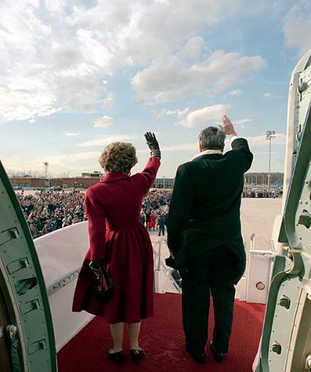
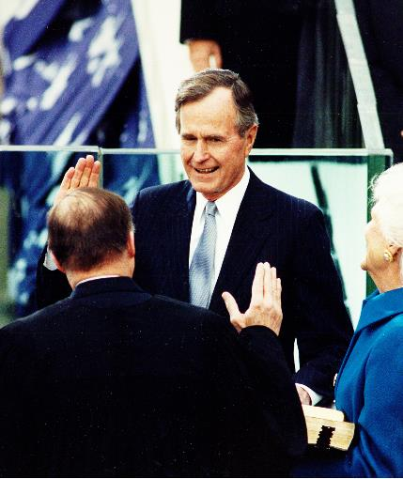
Legal Custody
“Upon the conclusion of a President’s term of office…the Archivist of the United States shall assume responsibility for the custody, control, and preservation of, and access to, the Presidential records of that President.”
Presidential Records Act
44 USC 2201-2209

Slide 13
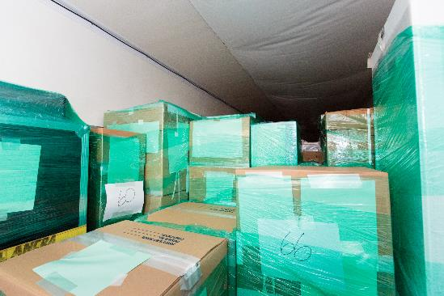
Physical Custody
Textual A/V Gifts COVID-19

Slide 14
Textual records, electronic records and emails
Not yet known

Slide 15
The Rise of Social Media

Slide 16
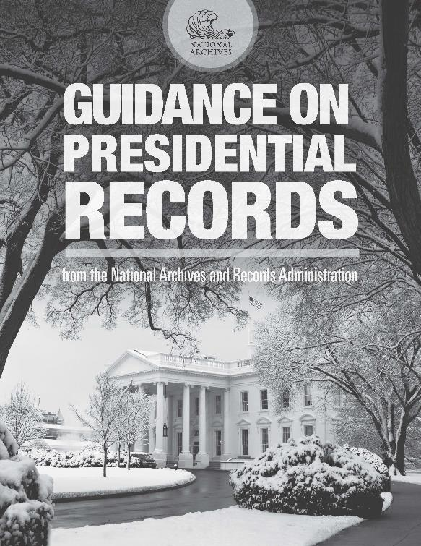
Additional Information
Presidential Transitions
Guidance on Presidential Records
Presidential Records Act
John Laster
john.laster@nara.gov

Slide 17
Changing Lanes: Transitioning between Gubernatorial administrations
CoSA – NARA webinar February 11, 2021
Jodie Foley, retired Montana State Archivist

Slide 18
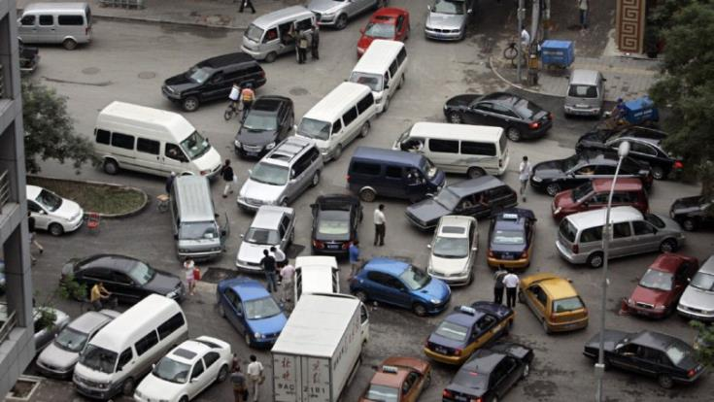
Merging
Merge Governor Bullock’s records out of active status and into Archives for access and preservation; and merging Governor Gianforte into active RM processes and setting up relationship for future transfer

Slide 19
Challenges
Dependence on gubernatorial administration cooperation
Outdated workflow
Changes in Governor’s office use of technology (specifically CRM)
High profile Governor (NGA Chair, Presidential Candidate, and U.S. Senate Candidate
and …. COVID

Slide 20
Overcoming challenges
Education
Communication / Relationship building
Flexibility
and wonderful staff in both MHS and Governor’s office

Slide 21
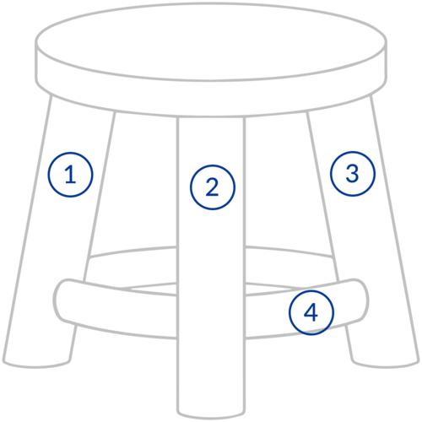
Education
Promotes efficiency and effectiveness
Supports open government transparency & accountability
It’s the law
Records create legacy
Speaking their language

Slide 22
Education
Update retention schedules (collaborative)
Staff tours (geared to natural interests, past administrations)
Sharing resources and follow-up for questions (SERI, ACCESS materials especially helpful)
Regular check-in meetings

Slide 23
Communication/Relationship Building
Develop layers of contacts:
Councils and Boards Coordinator, staff assistant and intern supervisors (most participated in our regular meetings)
IT speaking to IT, including vendors
Regular meetings on calendar (at first quarterly, in final year monthly, last quarter weekly)
Report training activities (DAS, webinars, reaching out to other states (re CRM systems)

Slide 24
Flexibility
Change as opportunity
Closed offices = time to research, update
Busy Governor’s staff meant focused reporting
Governor’s extracurriculars gave opportunity to discuss public vs private records
Work with what you have. We did not have a preservation system, but we did
DAS review, every CoSA and NAGARA webinar we could find, and
Pushed harder for Archivematica
COVID: TEAMS meetings, system screen shots, facility protocols for safe physical transfer

Slide 25
What we accomplished…areas to improve
Database (SQL) transfer (geographically redundant storage) as master (approx. 3 TB)
Excel spreadsheets (key word/unique identifier searchable) with attachments in separate storage, but tied
Permanent electronic records (in their original folder structure)
Training materials used for data entry and maintenance of CRM – includes screen shots to show “experience”
Website’s captured by State Library, other social media platforms addressed solely through CRM.
Is this perfect, no, but it buys us time to develop best practices and is a good base to build our next experience from.

Slide 26
Contacts:
Rich Aarstad, Montana State Archivist, raarstad@mt.gov
April Sparks, Montana Government Records Archivist, Asparks@mt.gov
Jodie Foley, retired State Archivist

Slide 27
Transition of Executive Branch State Agencies:
Office of the Governor
& Office of the Lt. Governor
Allen Ramsey, Assistant State Archivist

Slide 28
Records Management
The Connecticut State Library (CSL) is the public records office and the official state archives for the State of Connecticut​.
Connecticut General Statutes §11-8,§11-8a, and 7-109 grants authority for the records management program to CSL, Office of the Public Records Administrator (OPRA)​.
Records Management Liaison Officer (RMLO) and Assistant RMLO
Each executive branch state agency must appoint by statute a RMLO to coordinate records management activities for the agency and to serve as a liaison with OPRA.
Public Records Policy 05: Disposition of Public Records, https://ctstatelibrary.org/wp-content/uploads/2015/05/PRP05.pdf
Agency Specific records retention schedules, https://ctstatelibrary.org/agency-specific-records-retention-schedules/

Slide 29
Beginning of and During Term
State Librarian and/or Public Records Administrator sends memo welcoming new agency heads and senior management along with advising them of their record management responsibilities
Training of Office of the Governor and Office of the Lt. Governor staff both at beginning and as necessary / requested
Transfer of records prior to end of term or before the start of second term if re-elected
Public Records and State Archives staff available to answer questions

Slide 30
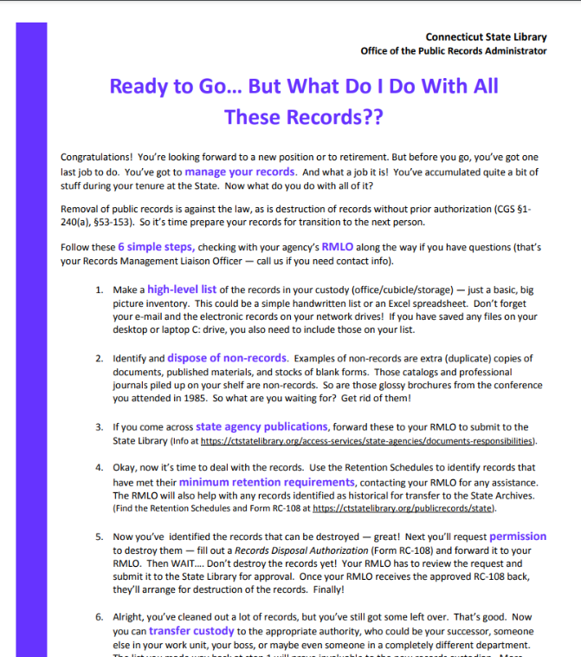
End of Term
The agency RMLO from the Office of the Governor Legal Office contacts State Archives staff in summer or early fall to schedule a meeting to discuss the transfer process, show Archives staff storage areas, etc.
Managing Records During Administrative Change memo with "Ready to Go… But What Do I Do With All These Records??" flyer sent to state agency commissioners, agency heads, and RMLOs in November-December

Slide 31
End of Term
2018 Gubernatorial transition of Governor Dannel P. Malloy
July 2018: State Library, Department of Administrative Services (DAS), and DAS Bureau of Enterprise System and Technology (DAS BEST) staff including the Chief Information Officer (CIO) met to discuss the preservation of electronic records from the Office of the Governor (OTG) and Office of the Lt. Governor (OTLG)
October 2018 through early January 2019: State Archives staff arrange pick up of analog records from OTG and OTLG
January 2019: Archives staff receive external hard drive with copies of OTG and OTLG shared network drives files, and internal hard drives from computers in both offices
January 9, 2019 after 12 noon: Receive access to social media accounts (Facebook, Twitter, YouTube, and Flickr) of the outgoing Governor Malloy and Lt. Governor Nancy Wyman administration
For more information see the SERI webinar “What Do You Mean I Can’t Do That With This Social Media Account?”, https://youtu.be/O7td47suf5g

Slide 32
Contact Information
Allen Ramsey
Assistant State Archivist
Email: Allen.Ramsey@ct.gov
Phone: (860) 566-1100 x. 302

Slide 33
Questions and Comments

Slide 34
Upcoming Webinars
February 25: CoSA Member Webinar – TBA
For registration information: https://www.statearchivists.org/programs/cosa-webinar-series/
March 9: SERI webinar – Selecting a Preservation Platform
For registration information: https://www.statearchivists.org/programs/state-electronic-records-initiative/seri-webinars/

Slide 35
Contact Us
CoSA Website http://www.statearchivists.org
CoSA Resource Center https://www.statearchivists.org/resource-center/
CoSA Twitter Handle @StateArchivists
CoSA Facebook Page www.facebook.com/CouncilOfStateArchivists
CoSA You Tube https://www.youtube.com/user/StateArchivists/

Slide 36
Contact Us
NARA Website http://archives.gov
NARA Twitter Handle: @USNatArchives
NARA Facebook Page: www.facebook.com/usnationalarchives
NARA Social Media Directory
http://www.archives.gov/social-media

Slide 37
Sponsors and Funders

Slide 38
Webinar Evaluation
We really do appreciate your feedback!
When you exit the webinar, you will automatically be taken to an online webinar evaluation. Please take a couple minutes to complete the survey and help us plan future webinars.

